Slide 1
Computer
Product
Suggestion

Slide 2
Group 13 - Team Member
1
Supervisor: Mr. Kiều Trọng Khánh
2
Phạm Hồng Sang
3
Huỳnh Thanh Việt
4
Trần Tân Lên
5
Hà Chí Danh (dropped out )

Slide 3
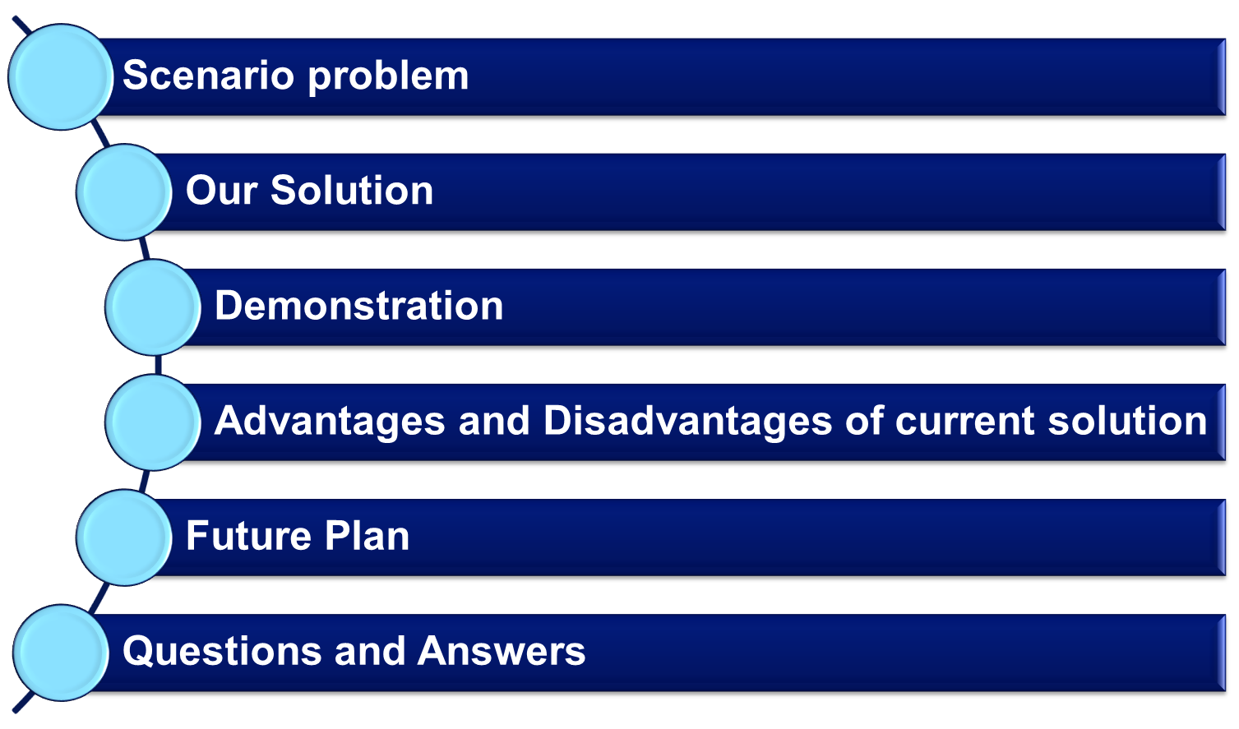
Outline

Slide 4
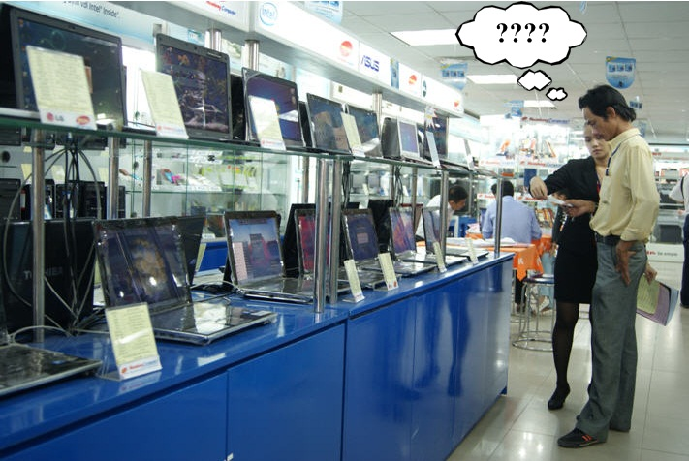
Scenario Problem

Slide 5
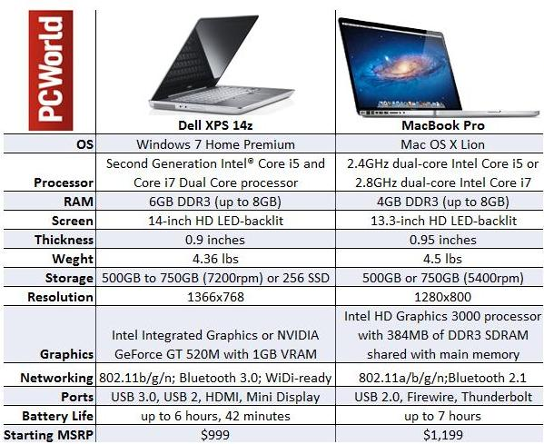
Scenario Problem

Slide 6
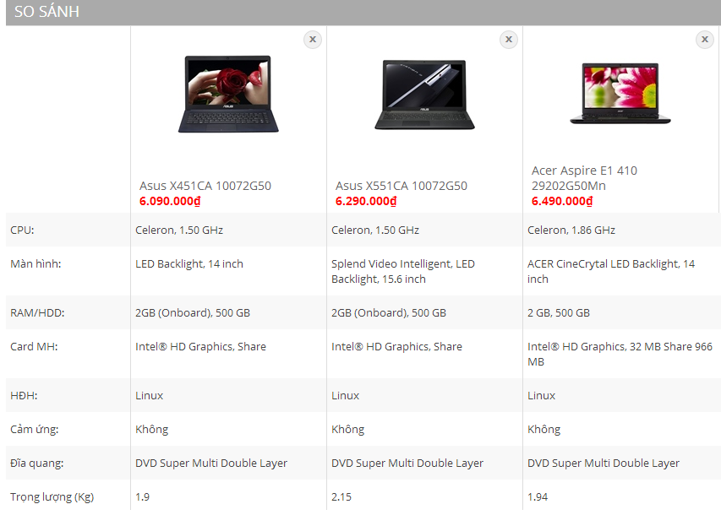
Scenario Problem

Slide 7
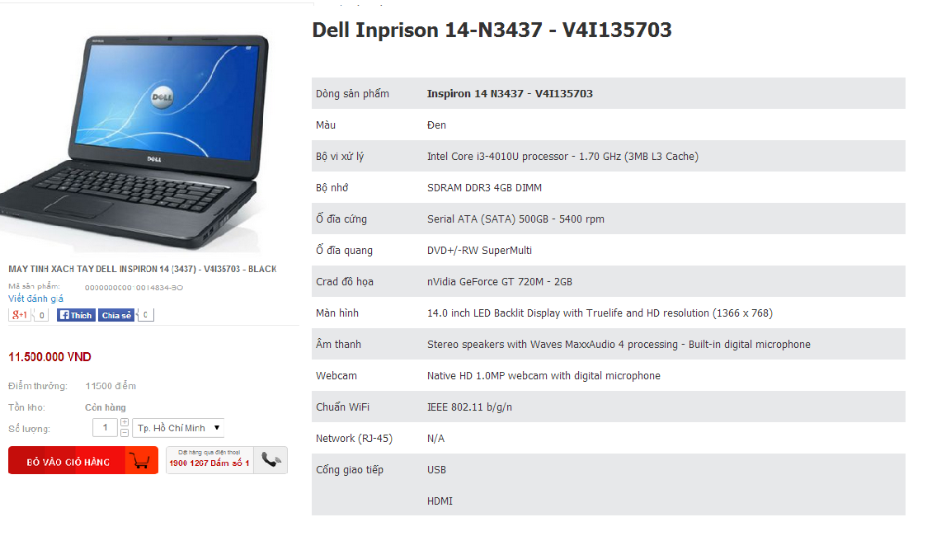
Scenario Problem

Slide 8
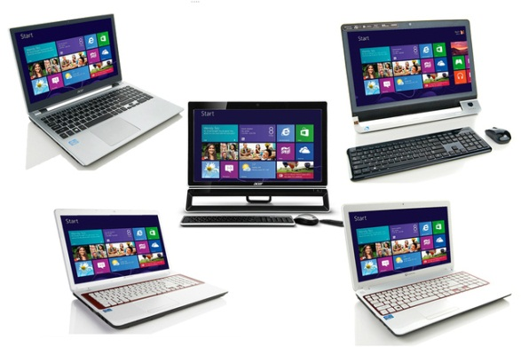
Scenario Problem

Slide 9



Our Ideas
Collect Data
Build Data System
Go Online

Slide 10





Our Solution
Add Your Title

Slide 11

Features

Slide 12

Demonstrations

Slide 13






Story Board

Slide 14



Demo Scenario - Guest
Search product
Add to cart
View compare

Slide 15



Demo Scenario - Member
Search product by Price
View Compare
Search Not Found
View Details
Recommend

Slide 16

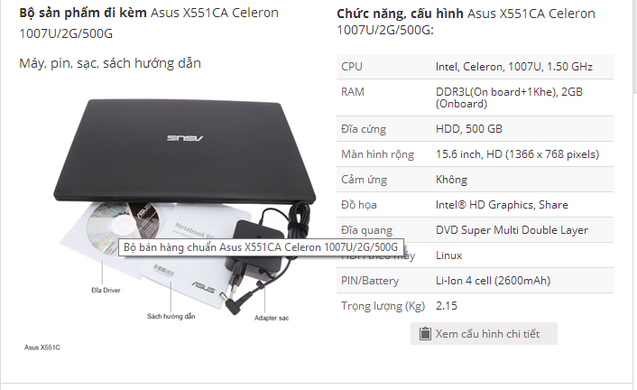
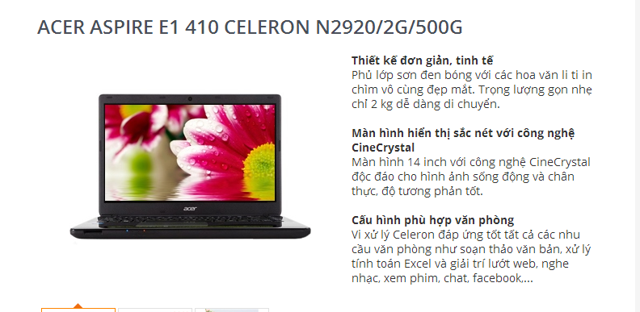
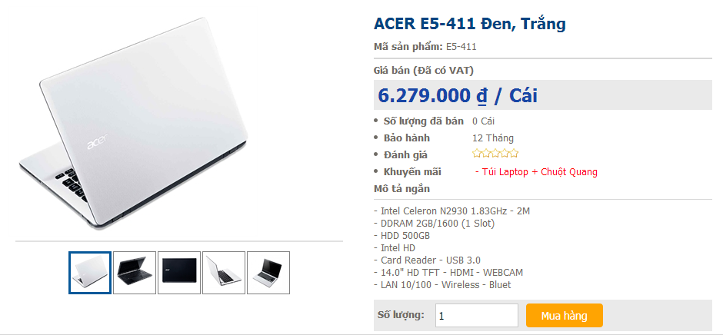
Data Source

Slide 17

Demo Scenario - Staff
Train machine
Get data from web

Slide 18
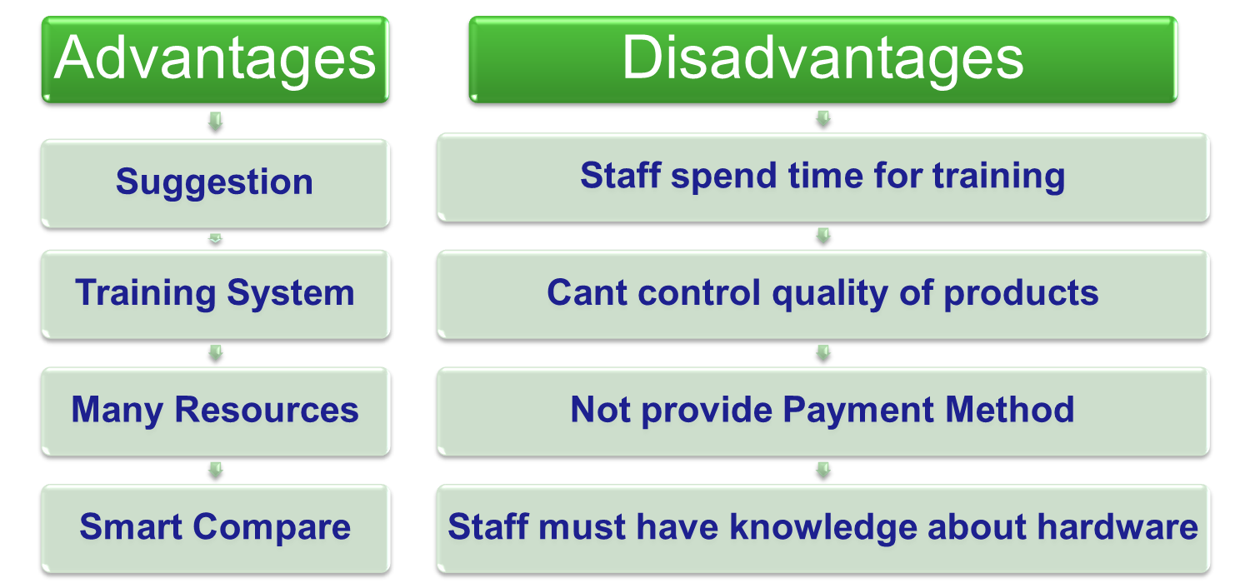
Advantages and Disadvantages

Slide 19

Thank You !
www.themegallery.com

